Slide 1

Copyright © 2014 Pearson Education, Inc. Publishing as Prentice Hall

Slide 2

Chapter 12
B2B E-commerce: Supply Chain Management and Collaborative Commerce
Copyright © 2014 Pearson Education, Inc. Publishing as Prentice Hall

Slide 3

Trends in B2B E-commerce
Flexibility: growing emphasis on rapid-response and optimal supply chains
Supply chain visibility—real time
Social commerce and customer intimacy
Large firms splinter global B2B systems into product- and region-centered systems
Big data and growing use of business analytics
Influence of mobile, social, and cloud platforms
Sustainable supply chains
Copyright © 2014 Pearson Education, Inc. Publishing as Prentice Hall
Slide 12-<number>
Notes:
• Flexibility: growing emphasis on rapid-response and optimal supply chains rather than lowest cost supply chains, which typically carry great risks.
• Supply chain visibility: growing calls for more real-time data that would allow managers to “see” across not only their production, but also “see into” the production and financial condition of their key suppliers.
• Social commerce and customer intimacy: buyers, like consumers, are tapping into their tablets, smartphones, and social network sites for purchasing, scheduling, exception handling, and deciding with their B2B customers and suppliers in order to manage supply chain risk.
• Large firms begin splintering single, global B2B platforms into product and region-centered systems to achieve lower risk, greater adaptability, and lower complexity.
• Market ownership: private B2B markets proliferate, especially as Web services, while public B2B markets stabilize in selected industries.
Big data: global trade and logistics systems are generating huge repositories of B2B data, swamping management understanding and controls.
• Business analytics: growing emphasis on use of business analytics software (business intelligence) to understand very large data sets.

Slide 4
Defining B2B Commerce
Before Internet:
  B2B transactions called trade or procurement process
Total inter-firm trade:
  Total flow of value among firms
B2B commerce:
  All types of computer-enabled inter-firm trade
B2B e-commerce:
  The portion of B2B commerce enabled by the Internet
Copyright © 2014 Pearson Education, Inc. Publishing as Prentice Hall
Slide 12-<number>

Slide 5
The Evolution of B2B Commerce
Automated order-entry systems
  Seller-side solution
Electronic data interchange (EDI)
  Buyer-side solution
  Hub-and-spoke system
  Serve vertical markets
B2B electronic storefronts
Net marketplaces
Private industrial networks
Copyright © 2014 Pearson Education, Inc. Publishing as Prentice Hall
Slide 12-<number>

Slide 6
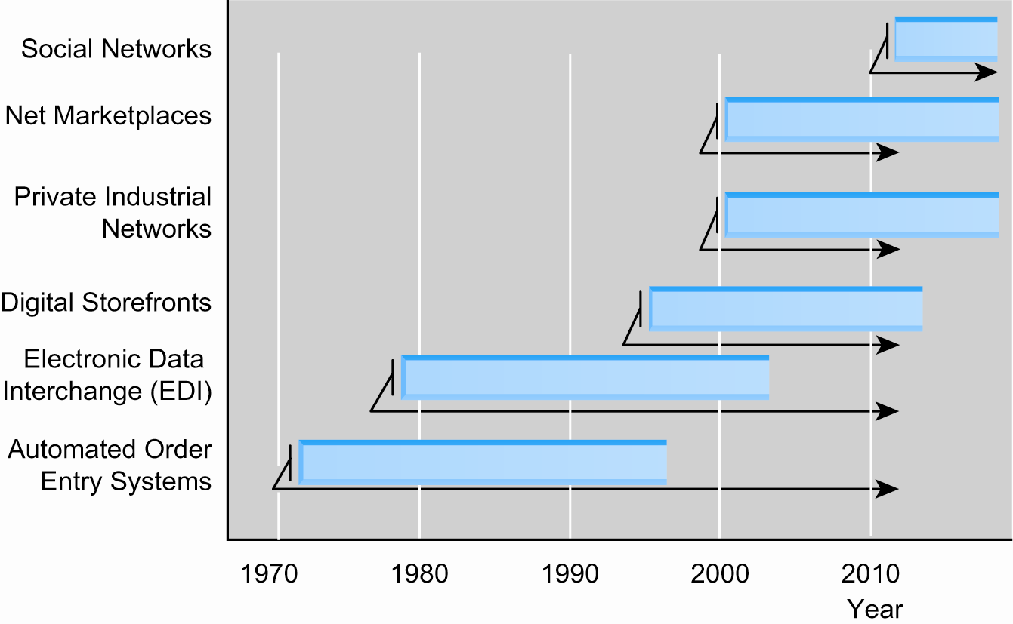
Evolution of the Use of
Technology Platforms in B2B Commerce
Figure 12.1, Page 751
Copyright © 2014 Pearson Education, Inc. Publishing as Prentice Hall
Slide 12-<number>

Slide 7
The Growth of B2B E-commerce
2012–2017: B2B e-commerce will grow from 40 to 42% of total inter-firm trade
Private industrial networks continue to play dominant role in B2B
Non-EDI B2B e-commerce most rapidly growing type of e-commerce
EDI still large but will decline over time
Copyright © 2014 Pearson Education, Inc. Publishing as Prentice Hall
Slide 12-<number>

Slide 8
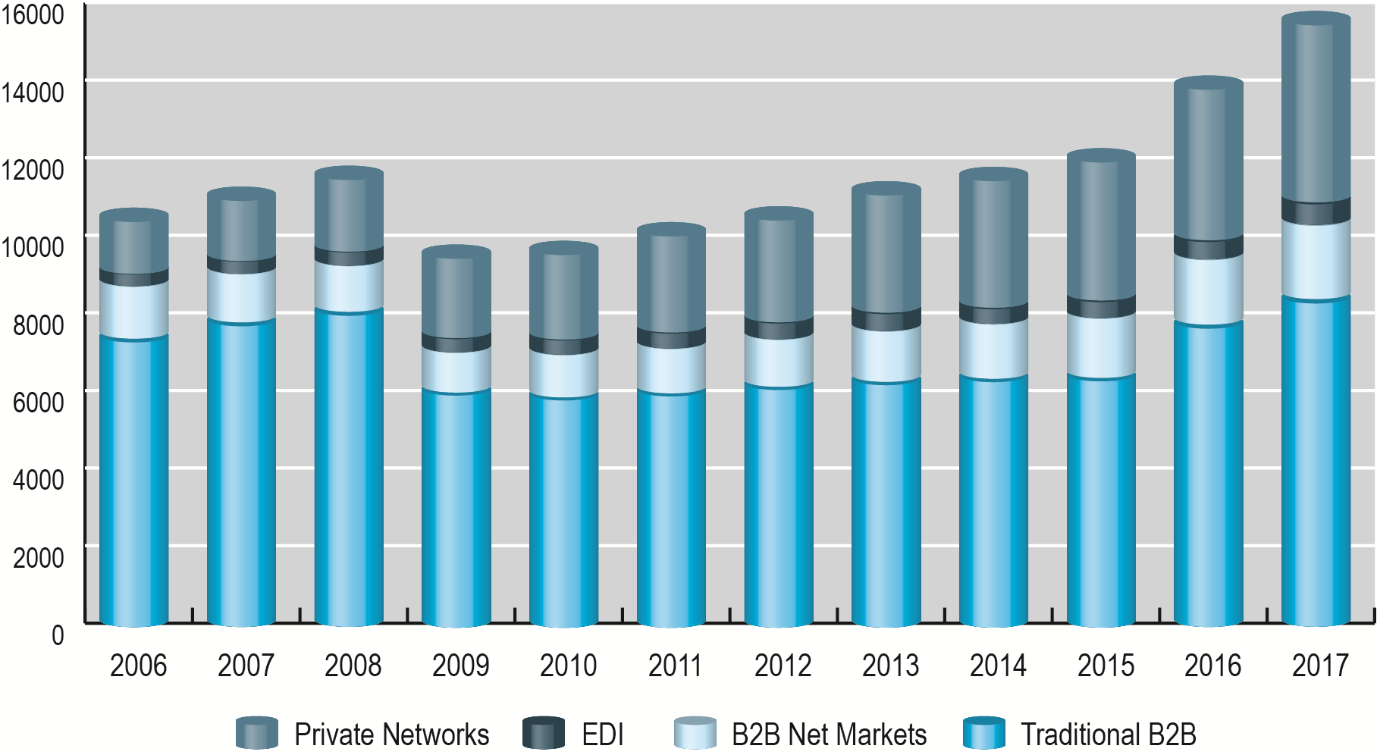
Growth of B2B Commerce 2000–2016
Figure 12.2, Page 753
SOURCES: Based on data from U.S. Census Bureau, 2013a; authors’ estimates.
Copyright © 2014 Pearson Education, Inc. Publishing as Prentice Hall
Slide 12-<number>

Slide 9
Industry Forecasts
Not all industries similarly affected by B2B
e-commerce
Not all industries would benefit equally
Factors influencing move to e-commerce
  Significant utilization of EDI
  Large investments in IT and Internet infrastructure
  Market concentrated on purchasing or selling
Copyright © 2014 Pearson Education, Inc. Publishing as Prentice Hall
Slide 12-<number>

Slide 10
Potential Benefits of B2B E-commerce
Lower administrative costs
Lower search costs for buyers
Reduced inventory costs
  Increasing competition among suppliers
  Reducing inventory carried
Lower transaction costs:
  Automation, eliminating paperwork
Increased production flexibility by ensuring just-in-time parts delivery
Copyright © 2014 Pearson Education, Inc. Publishing as Prentice Hall
Slide 12-<number>

Slide 11
Potential Benefits of B2B E-commerce (cont.)
Improved quality of products by increasing cooperation among buyers and sellers
Decreased product cycle time
Increased opportunities for collaboration
Greater price transparency
Increased visibility, real-time information sharing
However, some risk is posed by increased globalization and consolidation
Copyright © 2014 Pearson Education, Inc. Publishing as Prentice Hall
Slide 12-<number>

Slide 12
The Procurement Process and
the Supply Chain
Procurement process:
  The way firms purchase materials they need to make products
Steps in procurement process
  Deciding who to buy from and what to pay
  Completing transaction
  Each step is composed of many business processes and subactivities requiring data to be recorded in seller, buyer, and shipper information systems
Copyright © 2014 Pearson Education, Inc. Publishing as Prentice Hall
Slide 12-<number>

Slide 13
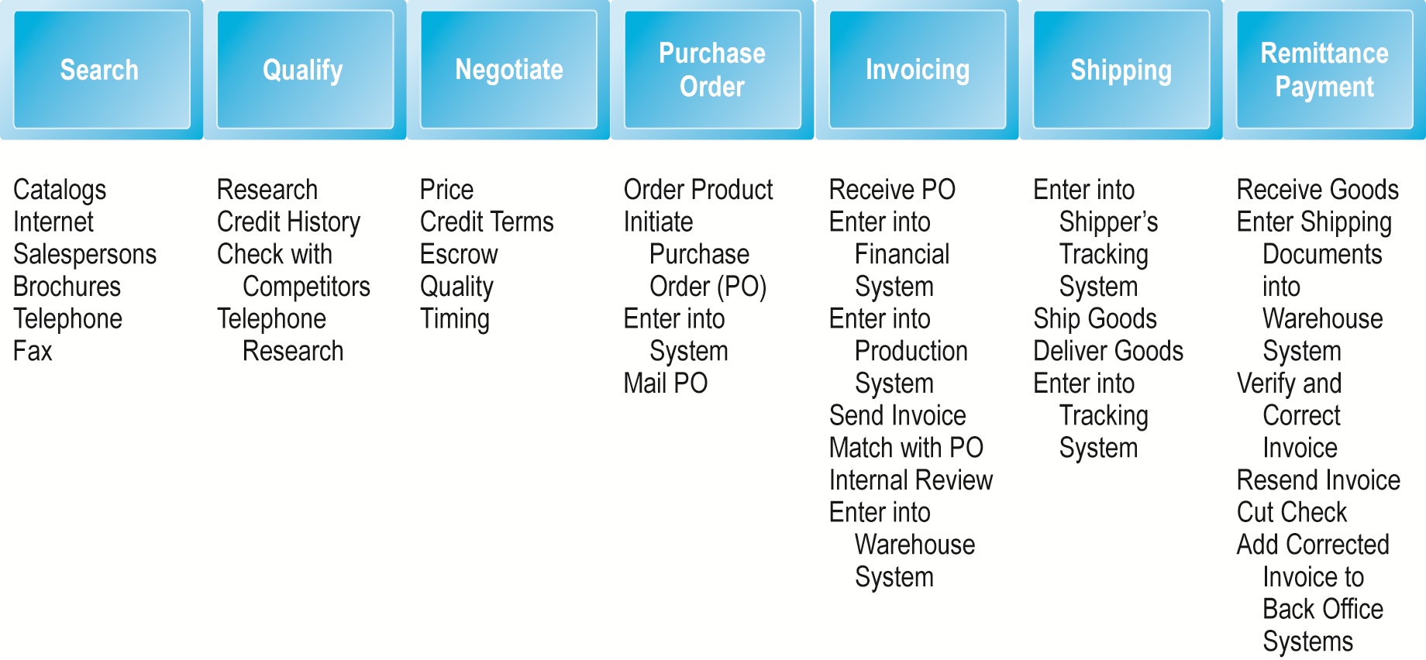
The Procurement Process
Figure 12.3, Page 758
Copyright © 2014 Pearson Education, Inc. Publishing as Prentice Hall
Slide 12-<number>

Slide 14
Types of Procurement
Firms purchase two types of goods
  Direct goods: Integrally involved in production process
  Indirect goods: All goods not directly involved in production process (MRO goods)
Firms use two methods to purchase
  Contract purchasing:
    Involves long-term written agreements to purchase specified products, with agreed-upon terms and quality
  Spot purchasing:
    Involves purchase of goods based on immediate needs in larger marketplaces that involve many suppliers
Copyright © 2014 Pearson Education, Inc. Publishing as Prentice Hall
Slide 12-<number>

Slide 15
The Role of Existing Legacy
Computer Systems
Legacy computer systems
  Generally, older mainframe and minicomputer systems used to manage key business processes within firm
Enterprise systems
  Corporate-wide
  Support/control all aspects of production, including
    Procurement
    Finance
    Human resources
Copyright © 2014 Pearson Education, Inc. Publishing as Prentice Hall
Slide 12-<number>

Slide 16
Trends in Supply Chain Management
Supply chain management (SCM)
  Activities used to coordinate key players in the procurement process
Major developments in SCM
  Just-in-time and lean production
  Supply chain simplification
  Adaptive supply chains
  Accountable supply chains
  Sustainable supply chains
  Electronic data interchange
  Supply chain management systems
  Collaborative commerce
Copyright © 2014 Pearson Education, Inc. Publishing as Prentice Hall
Slide 12-<number>

Slide 17
Electronic Data Interchange (EDI)
Broadly defined communications protocol for exchanging documents among computers
  Stage 1: 1970s–1980s—Document automation
  Stage 2: Early 1990s—Document elimination
  Stage 3: Mid-1990s—Continuous replenishment/access model
Today:
  EDI provides for exchange of critical business information between computer applications supporting wide variety of business processes
Copyright © 2014 Pearson Education, Inc. Publishing as Prentice Hall
Slide 12-<number>

Slide 18
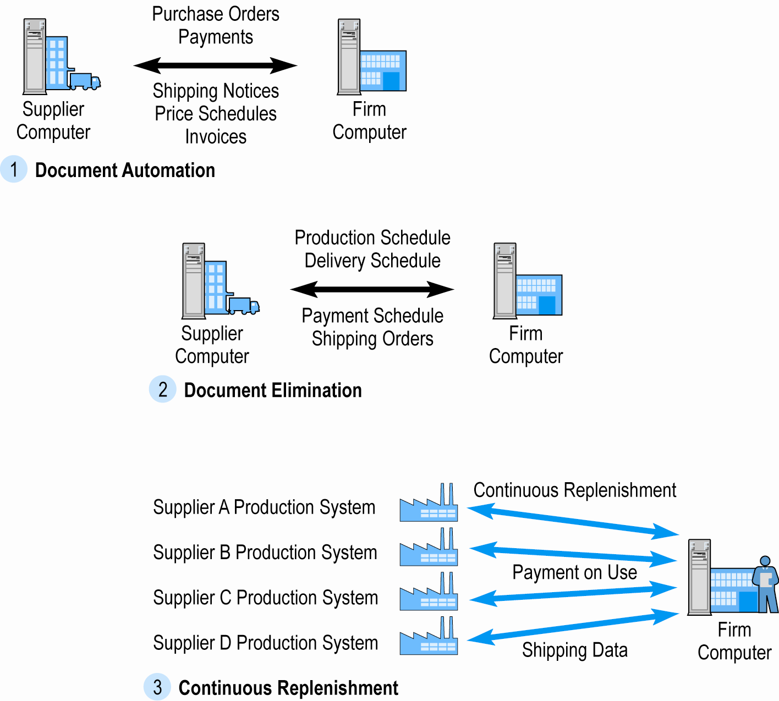
The Evolution of EDI as a B2B Medium
Figure 12.5, Page 766
Copyright © 2014 Pearson Education, Inc. Publishing as Prentice Hall
Slide 12-<number>

Slide 19
Supply Chain Management Systems
Continuously link activities of buying, making, and moving products from suppliers to purchasing firms
  SAP and Oracle Mobile apps for smartphones, tablets
Integrates demand side of business equation by including order entry system in the process
With SCM system and continuous replenishment, inventory is eliminated and production begins only when order is received
Hewlett Packard’s SCM system: Elapsed time from order entry to shipping PC is 48 hours
Copyright © 2014 Pearson Education, Inc. Publishing as Prentice Hall
Slide 12-<number>

Slide 20
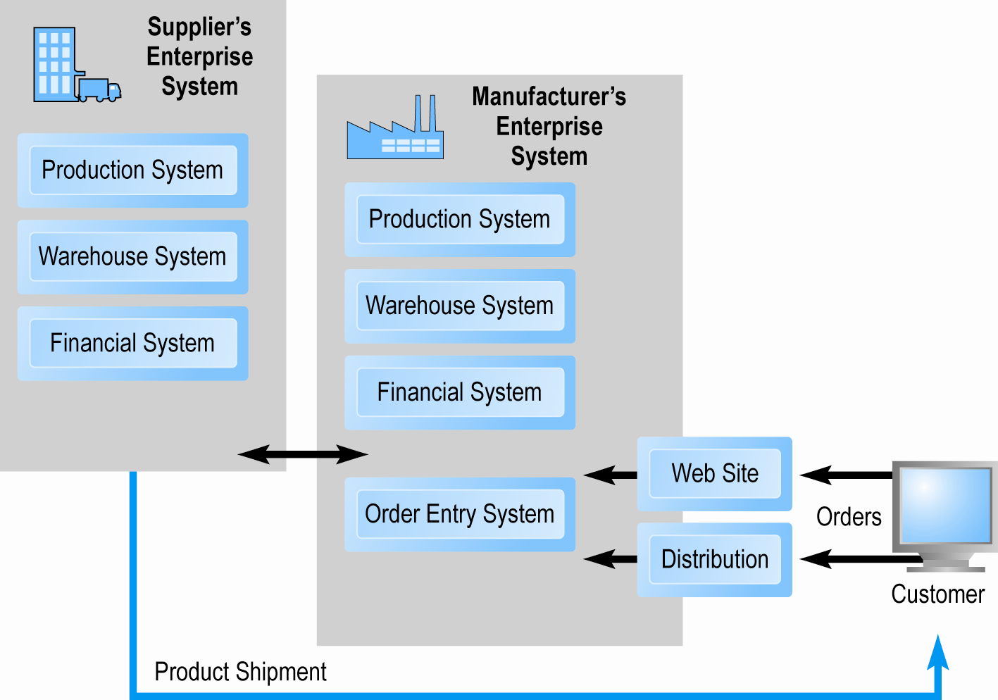
Supply Chain Management Systems
Figure 12.6, Page 768
Copyright © 2014 Pearson Education, Inc. Publishing as Prentice Hall
Slide 12-<number>

Slide 21
RFID Autoidentification:
Giving a Voice to Your Inventory
Why is RFID an improvement over bar codes?
How does RFID work?
How is Walmart utilizing RFID?
What impact will widespread adoption of RFID have on B2B e-commerce?
Copyright © 2014 Pearson Education, Inc. Publishing as Prentice Hall
Slide 12-<number>

Slide 22
Collaborative Commerce
Use of digital technologies for organizations to collaboratively design, produce, and manage products through life cycles
Moves focus from transactions to relationships among supply chain participants
Unlike EDI, more like an interactive teleconference among members of supply chain
Use of Internet technologies for rich communications environment
  Sharing designs, documents, messages, network meetings, videconferencing
Copyright © 2014 Pearson Education, Inc. Publishing as Prentice Hall
Slide 12-<number>

Slide 23
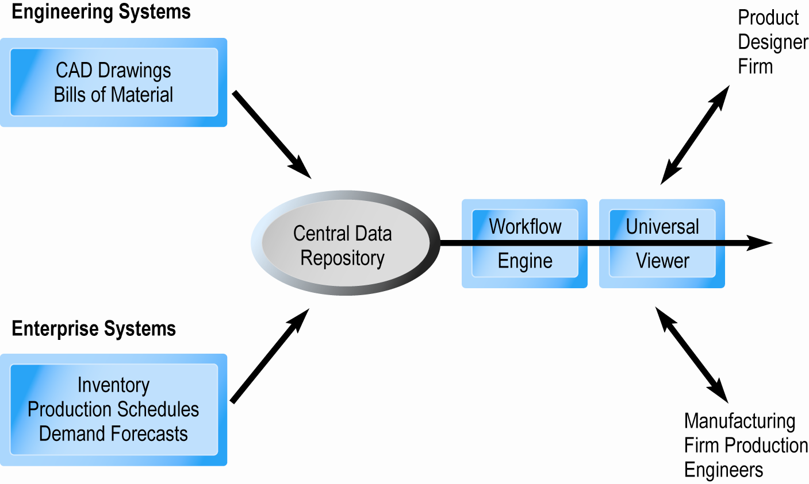
Elements of a Collaborative Commerce System
Figure 12.7, Page 772
Copyright © 2014 Pearson Education, Inc. Publishing as Prentice Hall
Slide 12-<number>

Slide 24
Social Networks and B2B
Social networks can provide personal connections that can help decision making in supply chain
Example: TradeSpace
Example: Dell’s YouTube channel
Example: Cisco’s Facebook pages for product campaigns for business clients
Copyright © 2014 Pearson Education, Inc. Publishing as Prentice Hall
Slide 12-<number>

Slide 25
Two Main Types of Internet-Based B2B Commerce
Net marketplaces:
  Bring together potentially thousands of sellers and buyers in single digital marketplace operated over Internet
  Transaction-based
  Support many-to-many as well as one-to-many relationships
Private industrial networks:
  Bring together small number of strategic business partner firms that collaborate to develop highly efficient supply chains
  Relationship-based
  Support many-to-one and many-to-few relationships
  Largest form of B2B e-commerce
Copyright © 2014 Pearson Education, Inc. Publishing as Prentice Hall
Slide 12-<number>

Slide 26
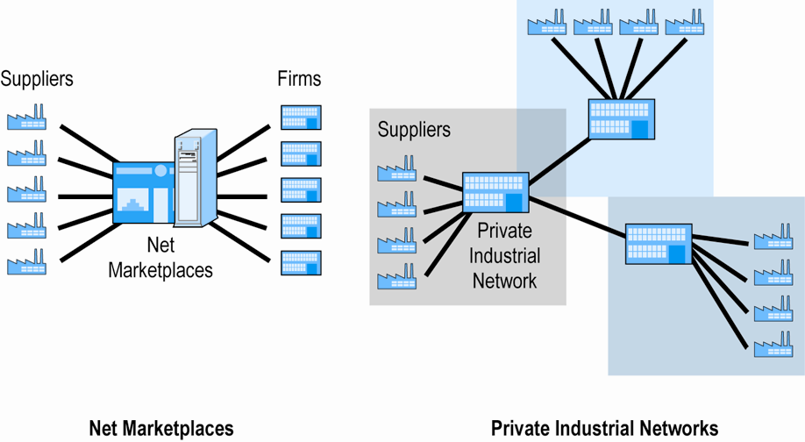
Two Main Types of Internet-Based B2B Commerce
Figure 12.8, Page 774
Copyright © 2014 Pearson Education, Inc. Publishing as Prentice Hall
Slide 12-<number>

Slide 27
Net Marketplaces
Ways to classify Net marketplaces:
  Pricing mechanism, nature of market served, ownership
By business functionality
  What businesses buy (direct vs. indirect goods)
  How businesses buy (spot purchasing vs. long-term sourcing)
  Four main types
    E-distributors
    E-procurement
    Exchanges
    Industry consortia
Copyright © 2014 Pearson Education, Inc. Publishing as Prentice Hall
Slide 12-<number>

Slide 28
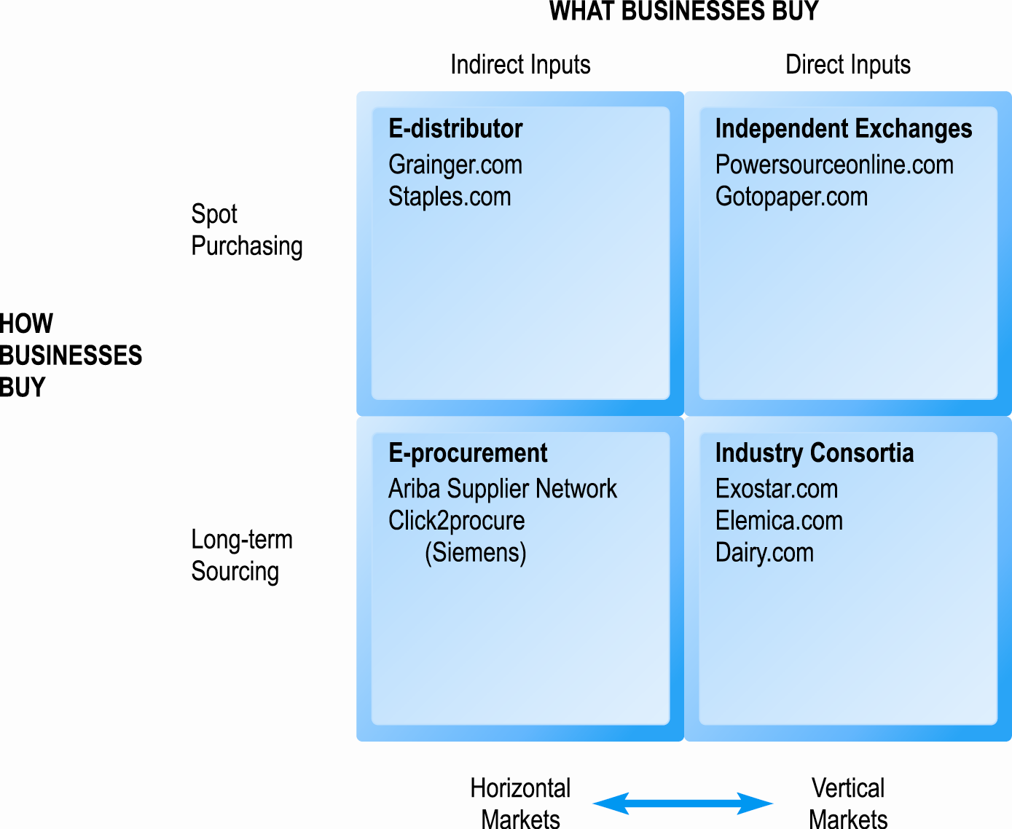
Pure Types of Net Marketplaces
Figure 12.9, Page 776
Copyright © 2014 Pearson Education, Inc. Publishing as Prentice Hall
Slide 12-<number>

Slide 29
E-distributors
Most common type of Net marketplace
Electronic catalogs representing products of thousands of direct manufacturers
Typically, independently owned intermediaries
Offer industrial customers single source to purchase indirect goods on spot basis
Typically, horizontal
Usually, fixed price—discounts for large customers
Example: W.W. Grainger
Copyright © 2014 Pearson Education, Inc. Publishing as Prentice Hall
Slide 12-<number>
Notes:
E-distributors operate in horizontal markets because they serve many different industries with products from many different suppliers. E-distributors usually operate “public” markets in the sense that any firm can order from the catalog, as opposed to “private” markets, where membership is restricted to selected firms.

Slide 30
E-procurement Net Marketplaces
Independently owned intermediaries
Connect hundreds of suppliers of indirect goods
Firms pay fees to join market
Long-term contractual purchasing of indirect goods
Revenues from transaction fees, licensing consultation services and software, network fees
Offer value chain management (VCM) services
Many-to-many market
Example: Ariba
Copyright © 2014 Pearson Education, Inc. Publishing as Prentice Hall
Slide 12-<number>
Notes:
Value chain management (VCM) services provided by e-procurement companies include automation of a firm’s entire procurement process on the buyer side and automation of the selling business ­processes on the seller side. For purchasers, e-procurement companies automate purchase orders, requisitions, sourcing, business rules enforcement, invoicing, and payment. For suppliers, e-procurement companies provide catalog creation and content management, order management, fulfillment, invoicing, shipment, and settlement.
They are mediated by an independent third party that purports to represent both buyers and sellers, and hence claim to be neutral.

Slide 31
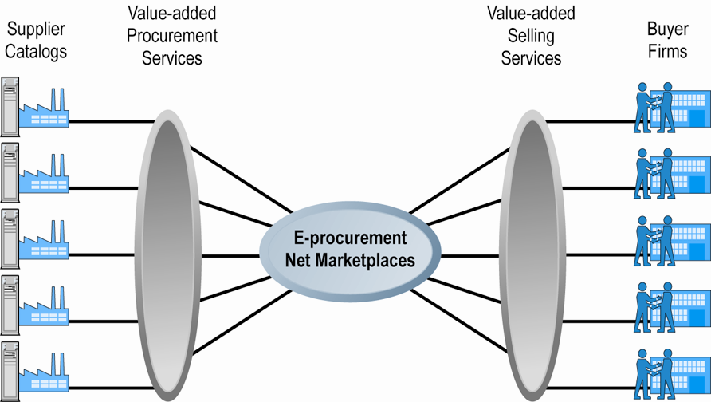
E-procurement Net Marketplaces
Figure 12.11, Page 779
Copyright © 2014 Pearson Education, Inc. Publishing as Prentice Hall
Slide 12-<number>

Slide 32
Exchanges
Independently owned online marketplaces
Connect hundreds to thousands of suppliers and buyers in dynamic, real-time environment
Vertical markets, spot purchasing in single industry
Charge commission fees on transaction
Variety of pricing models
Tend to be buyer-biased
Suppliers disadvantaged by competition
Copyright © 2014 Pearson Education, Inc. Publishing as Prentice Hall
Slide 12-<number>

Slide 33
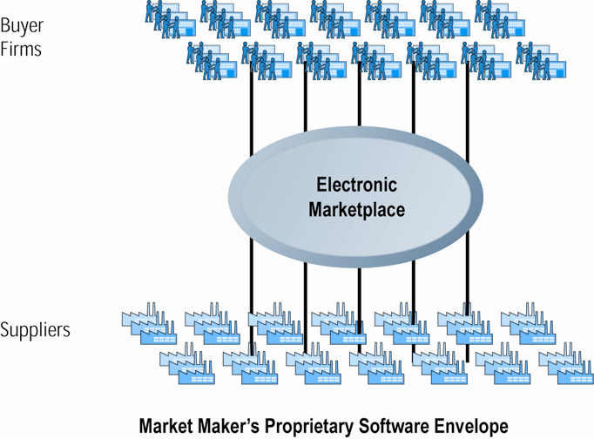
Exchanges
Figure 12.12, Page 780
Copyright © 2014 Pearson Education, Inc. Publishing as Prentice Hall
Slide 12-<number>

Slide 34
Industry Consortia
Industry-owned vertical markets
Purchase of direct inputs from set of invited participants
Emphasize long-term contractual purchasing, stable relationships, creation of data standards
Ultimate objective:
  Unification of supply chains within entire industries through common network and computing platform
Revenue from transaction and subscription fees
  Many different pricing mechanisms
Can force suppliers to use consortia’s networks
Copyright © 2014 Pearson Education, Inc. Publishing as Prentice Hall
Slide 12-<number>
Notes:
An industry consortium is a group that involves representatives from several different companies. Usually, consortia are composed of companies from within a single industry.
An industry consortium is an industry-owned vertical market that enables buyers
to purchase direct inputs (both goods and services) from a limited set of invited
participants (see Figure 12.13). Industry consortia emphasize long-term contractual purchasing, the development of stable relationships (as opposed to merely an anonymous transaction emphasis), and the creation of industry-wide data standards and Net Marketplaces synchronization efforts. Industry consortia are more focused on optimizing long-term supply relationships than independent exchanges, which tend to focus more on short-term transaction
Industry consortia bring thousands of suppliers into direct contact with a smaller number of very large buyers. The market makers provide value-added software services for procurement, transaction management, shipping, and payment for both buyers and suppliers. Industry consortia are sometimes referred to as many-to-few markets, where many suppliers (albeit selected by the buyers) serve a few very large buyers, mediated by a variety of value-added services.

Slide 35
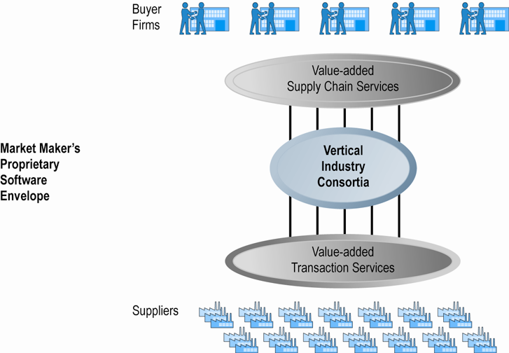
Industry Consortia
Figure 12.13, Page 782
Copyright © 2014 Pearson Education, Inc. Publishing as Prentice Hall
Slide 12-<number>

Slide 36
Private Industrial Networks
Private trading exchanges (PTXs)
Web-enabled networks for coordination of trans-organizational business processes (collaborative commerce)
  Direct descendant of EDI; closely tied to ERP systems
  Manufacturing and support industries
  Single, large manufacturing firm sponsors network
Range in scope from single firm to entire industry
Example: Procter & Gamble
Copyright © 2014 Pearson Education, Inc. Publishing as Prentice Hall
Slide 12-<number>
Notes:
private industrial networks are direct descendants of existing EDI networks, and they are closely tied to existing ERP systems used
by large firms.
For the most part, these networks originate in and closely
involve the manufacturing and related support industries, and therefore we refer to them as “industrial” networks, although in the future they could just as easily apply to some services.

Slide 37
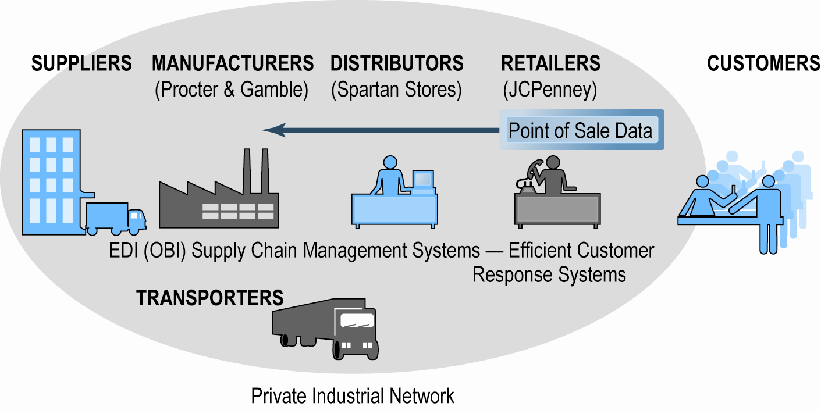
P&G’s Private Industrial Network
Figure 12.15, Page 787
Copyright © 2014 Pearson Education, Inc. Publishing as Prentice Hall
Slide 12-<number>

Slide 38
Characteristics of Private
Industrial Networks
Objectives include:
  Efficient purchasing and selling industry-wide
  Industry-wide resource planning to supplement enterprise-wide resource planning
  Increasing supply chain visibility
  Closer buyer–supplier relationships
  Global scale operations
  Reducing industry risk by preventing imbalances of supply and demand
Focus on continuous business process coordination
Typically, focus on single sponsoring company that “owns” the network
Copyright © 2014 Pearson Education, Inc. Publishing as Prentice Hall
Slide 12-<number>

Slide 39
Implementation Barriers
Concerns about sharing of proprietary, sensitive data
Integration of private industrial networks into existing ERP systems and EDI networks difficult, expensive
Requires change in mindset and behavior of employees and suppliers
  All participants lose some independence
Copyright © 2014 Pearson Education, Inc. Publishing as Prentice Hall
Slide 12-<number>

Slide 40
Copyright © 2014 Pearson Education, Inc. Publishing as Prentice Hall
Slide 12-<number>

